Slide 1
Navigation Challenge
Python with Robots Mission 3
Lesson 4 Objectives 9-11

Slide 2

Pre-Mission Warm-Up
In your Mission 3 Lesson 4 log, answer the pre-mission warm-up questions:
How do you move CodeBot forward?
How do you rotate CodeBot clockwise?

Slide 3
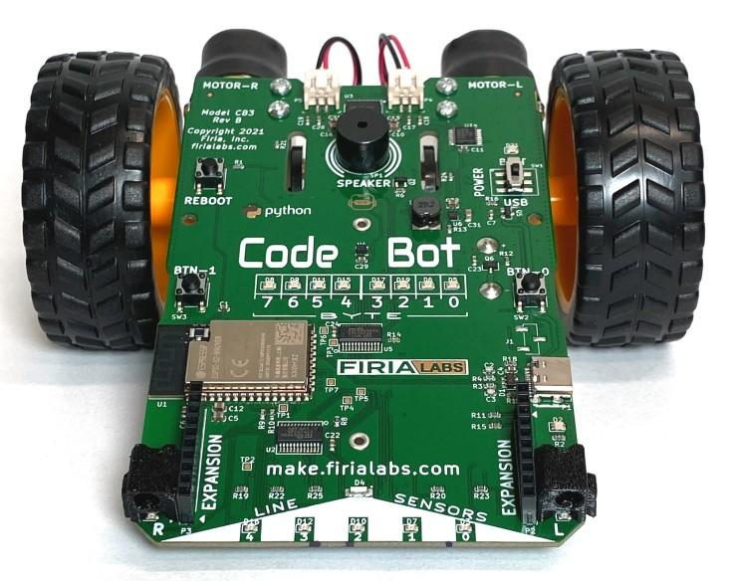
Mission 3: Push Button Controls
Every time you run a program, the CodeBot starts moving.
Yikes!
We need a safety feature.
I only want the ‘bot to move if I push a button first.

Slide 4
Mission 3: Push Button Controls
The botcore function buttons.was_pressed() can be used as a safety feature.
Using the function as the condition of an if statement, the program will run code only if a specified button is pressed.
The buttons.was_pressed() is the condition.
Its possible values are True or False.

Slide 5
Mission 3: Push Button Controls
It works like this:
if buttons.was_pressed(0): indented code here
The indented code will run only if BTN-0 was pressed.
Pressing <enter> after the colon (:) will automatically indent code by 4 spaces when you are typing.

Slide 6
Mission 3: Push Button Controls
Let’s add a countdown and delay to our safety feature to give us time to press the button.
How long will it take you to press RUN on your computer, and then unplug your CodeBot and go to the testing station on the floor?
Use this amount of time for your delay.

Slide 7
Mission 3: Push Button Controls
For example, use 30 seconds as your countdown time.
This gives you 30 seconds to click <RUN>, unplug the ‘bot, set the ‘bot on the floor, and press <BTN-0>.
Your safety feature code could look like this:
leds.user(0b00011000) sleep(30)
leds.user(0)
if buttons.was_pressed(0):
indented code here

Slide 8
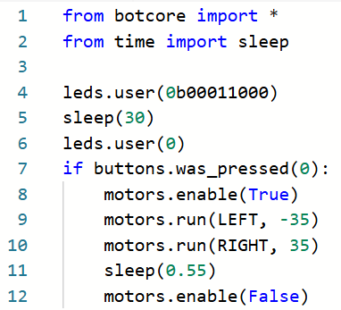
Mission 3: Push Button Controls
Give it a try!
Open the MoveOut program.
Add this code to your program.
Indent the lines of code inside the if statement.
You can use a shorter delay time if you are testing at your desk.
Run your program, unplug the CodeBot, and press the button during the delay.

Slide 9
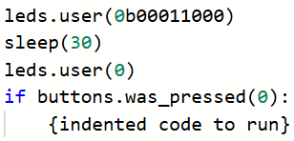
Mission 3: Push Button Controls
Moving forward, you will use this safety feature in your programs.

Slide 10

Objective #9: Navigation Challenge!
For this objective you will face a problem to solve with code.
It’s going to require a series of steps.
You need an algorithm!

Slide 11
Objective #9: Navigation Challenge!
An algorithm is a list of instructions, in order, that the computer can follow to complete a task.
Algorithm:
Step 1: turn on user LEDs
Step 2: wait 1 second
Step 3: turn off user LEDs
Step 4: wait 1 second
Step 5: enable motors
Step 6: move forward
Step 7: wait 2 seconds
Step 8: disable motors

Slide 12

Objective #9: Navigation Challenge
Program CodeBot to drive a square.
What are the steps?
Think about the algorithm.
The ‘bot can turn clockwise or counterclockwise – your choice.

Slide 13
Objective #9: Navigation Challenge
The algorithm might start like this:
Import libraries
Safety feature
Enable motors
Go forward 12 inches
Turn 90∘
Go forward 12 inches …

Slide 14
Objective #9 Activity
DO THIS:
Write your complete algorithm in your mission log.

Slide 15
Objective #9: Navigation Challenge
Divide and Conquer.
Break down your problem into bite-sized pieces.
That means, just do one step at a time. Get it to work before moving on to the next step.
Keep your code organized and easy to read.
This is a good time to use comments and white space

Slide 16
Objective #9: Navigation Challenge
Comments and White Space
Comments are notes in the code that explain what you are doing.
They are ignored by the computer.
A comment starts with #
Anything after the # is part of the comment: # This is a comment

Slide 17
Objective #9: Navigation Challenge
Comments and White Space
You can also use blank lines (called white space) to separate sections of code.
A combination of comments and blank lines can keep your code organized and easy to read.

Slide 18
Objective #9 Activity
DO THIS:
Start a new file called NavSquare.
Start the program by following your algorithm.
The algorithm describes the steps, but you have to write the instructions in Python.

Slide 19
Objective #9 Activity
DO THIS:
Use comments and blank lines to organize your code.
Program just the first few steps.
Use the data from the robot labs completed in Lesson 3 for the powers and sleep delays that will move CodeBot forward and turn 90 degrees.

Slide 20
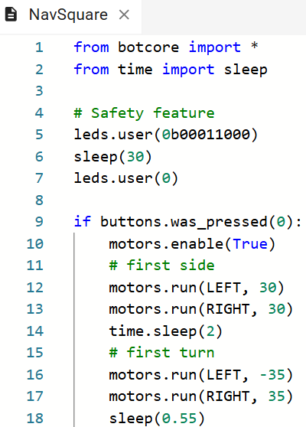
Objective #9 Activity
POSSIBLE CODE:
Take time to get the first side correct.
Use your data for the side and the turn.

Slide 21
Objective #9 Activity
DO THIS:
Once you have one side and rotation just the way you want it you can:
Copy and paste the code again for the second side.
Use another comment and blank line to organize your code.
Test your code and take time to get it correct.

Slide 22
Objective #9 Activity
DO THIS:
Repeat this process until you have a square!

Slide 23

Objective #10: Choose Your Adventure!
Right now you have one choice in your safety feature.
But you have 2 buttons, so how about 2 choices?!
You need a way to change the control flow of your program.
Control flow means there are decision points in your code, allowing the computer to take a different path depending on a condition.

Slide 24
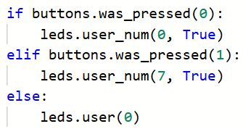
Objective #10: Choose Your Adventure!
The current if statement in your safety feature has one option – called a branch.
An if statement can have more than one branch.
This example has three branches.

Slide 25
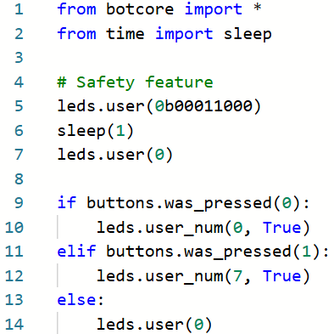
Objective #10 Activity
DO THIS:
Let’s see how the if statement works.
Start a new file called WhatIf.
Use the code to the right.

Slide 26



Objective #10 Activity
DO THIS:
Click DEBUG to “Step In” the code.
You will do this three times.
First time: when this line is highlighted
press BTN-0. Then keep pressing
What happens? Record your observation in the mission log.

Slide 27
Objective #10 Activity
DO THIS:
Second time: Click and “Step In” . When the same line is highlighted press BTN-1. Then keep pressing
What happens? Record your observation in the mission log.

Slide 28
Objective #10 Activity
DO THIS:
Third time: Click and “Step In” .
Do not press either button. Just keep pressing
What happens? Record your observation in the mission log.

Slide 29
Objective #10 Activity
SUMMARY:
Using control flow with an if statement:
If the first condition is True, the first indented code is executed, and the rest of the code is skipped.
If the first condition is False and the second condition is True, the first branch is skipped, the code in the second branch is executed, and the rest of the code is skipped.
If the first and second conditions are False, only the code for the else is executed.

Slide 30

Objective #11: Button Up!
Now that you’ve mastered buttons and control flow, you can make the WhatIf program more interesting.
Use the safety feature.
Use the if/elif/else control flow structure.
Code the ‘bot to do two different things.

Slide 31
Objective #11: Button Up!
Here is an algorithm for the WhatIf program:
Import libraries
Safety feature
if button 0 is pressed:
Move the ‘bot in a square (NavSquare program)
elif button 1 is pressed:
Have the ‘bot give a light show (Sequence LEDs or BinaryLEDs program)
else:
Turn on all LEDs and then off all LEDs

Slide 32
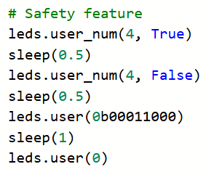
Objective #11 Activity
DO THIS:
Add this code to your safety feature:

Slide 33
Objective #11 Activity
DO THIS:
Open your NavSquare program.
Copy the code that moves the ‘bot in a square.
Paste it in the indented code for if buttons.was_pressed(0):

Slide 34
Objective #11 Activity
DO THIS:
Open either SequenceLEDs or BinaryLEDs.
Copy the code for the light show.
Paste it in the indented code for elif buttons.was_pressed(1):
Note: Make sure ALL the code for the light show is indented inside the elif statement.

Slide 35
Objective #11 Activity
DO THIS:
Add to the code indented inside else:
You can have the ‘bot do anything. My suggestion is to turn on all LEDs, wait, and then turn off all LEDs.
Note: Make sure ALL the code is indented inside the else: statement.

Slide 36
Post-Mission Reflection
Complete the post-mission reflection in your Mission 3 Lesson 4 Log

